Slide 2
Announcements
PwnEd7 Qualifiers upcoming (Sat 7th Feb)
Q-Zips W/C 25/01 (No later than W/C 11/02
2026/2027 DMU Hackers Committee!
Chairman
Secretary
Wellbeing Officer
Treasurer
5 minute talks (12th Feb) [ 1st week back after RW ]

Slide 3
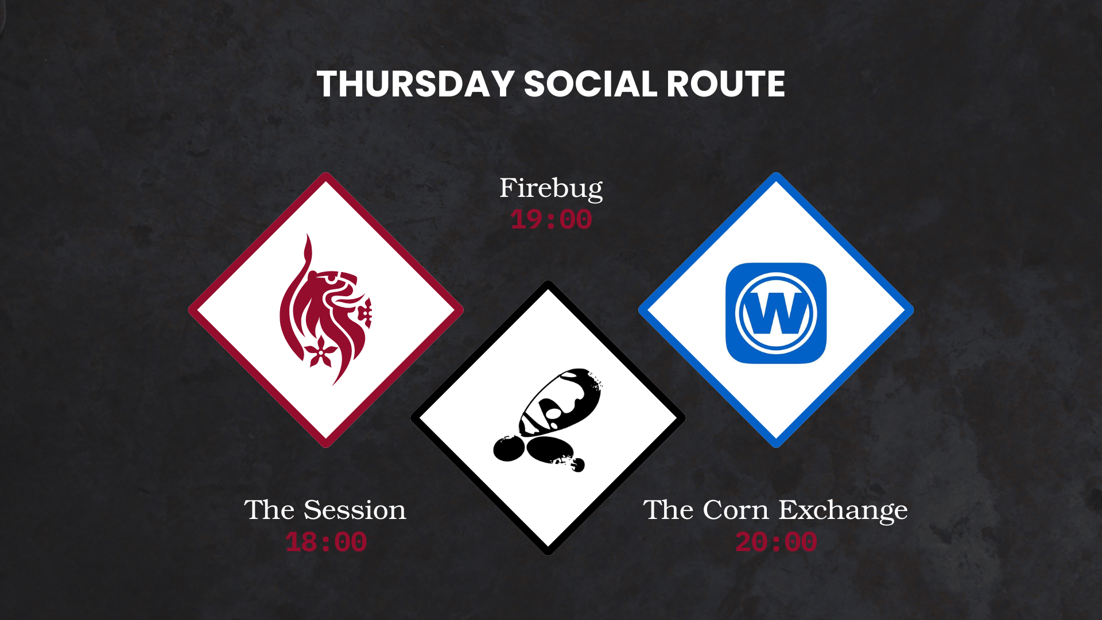

Slide 4
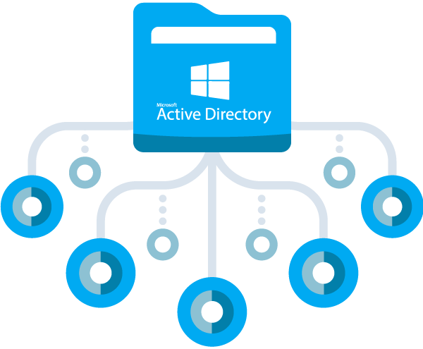

Slide 5

What is Active Directory?
Microsoft debuted AD in 1999, was released in 2000
Designed as a system for storing and supplying directory data to devices on networks
Originally started as one service (AD DS)
Organises users devices into forests, trees and domains, storing user information such as usernames, passwords, phone numbers etc

Slide 6
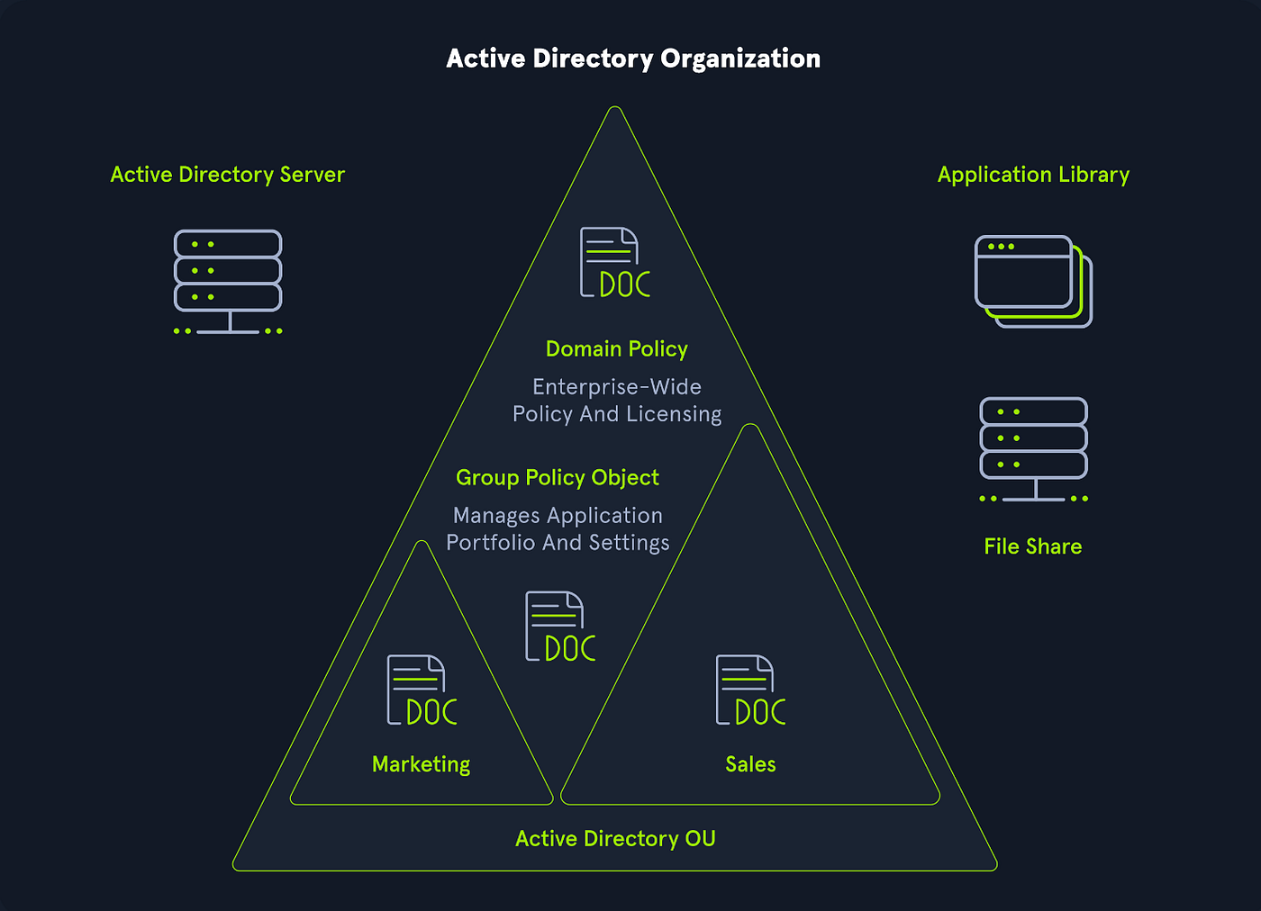

Slide 7
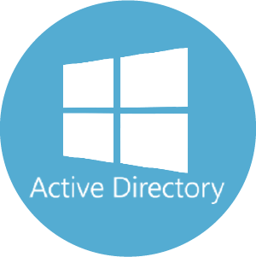
Approximately 90% of global Fortune 1000 companies rely on AD
Gaining unauthorised access to a high-privileged AD account gains the “keys to the kingdom”
Essentially most businesses run AD
AD can be extremely vulnerable, largely due to misconfiguration and its complexity to manage and secure

Slide 8
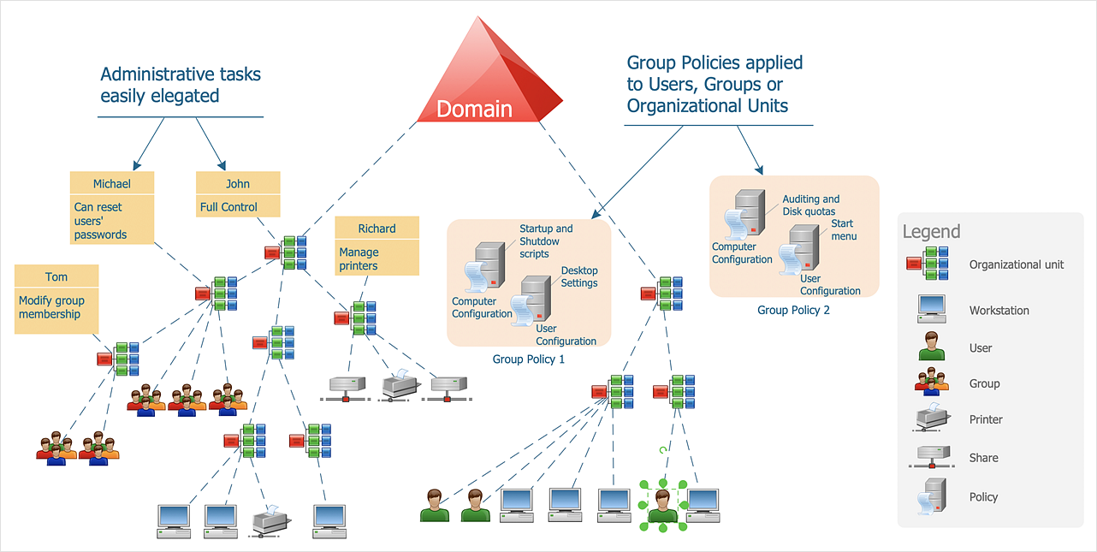

Slide 9
Domains
Logical grouping of objects (users,departments,groups blah blah blah) that share a common directory database and policies
Can be part of a larger forest, sharing common schema and trust relationships
Used to separate organisations (mainly large) so that they can be manageable security boundaries
Communication within domains usually take place via SMB and LDAP

Slide 10

Domain controller
Physical or virtual Server that is responsible for running AD DS
It hosts a copy of the AD database, responds to login requests, validates credentials, and enforces policies
Replicates directory changes with other DCs
A domain can have multiple domain controllers (typically for redundancy and load balancing)
One of its many functionalities is to act as a DNS server, used for communication between devices

Slide 11
OUs (Organisational Unit/s)
Container within a domain that is used to organise objects by hierarchy
They exist purely for delegation of administrative control, GPOs can be applied to them to enforce settings on the objects inside of them
OUs help logically structure objects within a single domain
Each OU can have its own GPO but they still belong to the same domain security boundary

Slide 12

Default Groups
Default groups are created automatically when a domain or forest is set up, providing built-in roles and permissions
Enterprise Administrators-full control over forest, forest root creator
Domain Administrators-full domain control
Domain Users-basic user rights, default user group
Domain Computers-default group all computers are in

Slide 13
Kerberos
Default authentication protocol that is designed to provide “secure” ticket-based logon without the need of transmitting plaintext passwords
Kerberos was originally created by MIT in the 1970s, later integrating kerberos V5 into windows 2000 Active Directory
Some key components of Kerberos
KDC(Key Distribution Center): Runs on DCs, handles ticket issuance
TGT(Ticket Granting Ticket): proof of identity when requesting tickets
Service ticket: Grants access to specific resources
PAC(Privileged Attribute Certificate): Contains user’s group membership and privileges
SPN(Service Principle Name): Unique Identifiers assigned when a service is installed or when a computer joins a domain

Slide 14
AD DS: Domain service (2000)
AD LDS: Lightweight Directory Service (2003, expanded in 2008)
AD CS: Certificate Service (2003)
AD FS: Federation Service (2003, expanded in 2008)
AD RMS: Rights Management Services (2003)

Slide 15
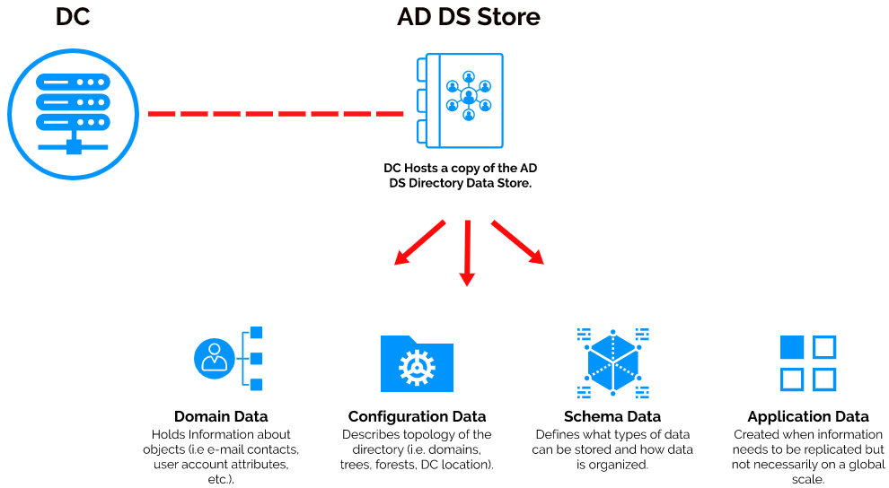

Slide 16
AD DS
Server role in windows server that provides the directory service
Foundation, heart of AD, the basis for other AD service components
Stores information about objects
Provides authentication (Kerberos, NTLM) and authorization (access control)
Manages domain hierarchies (forests, trees and OUs)
Replicates data across DCs for centralised network administration
Dominant component and is essential in windows-based enterprise networks

Slide 17
AD LDS
Was originally called ADAM (AD Application Mode)
Main purpose is to provide directory services without requiring domains or forests
Primarily communicates using LDAP, suitable for the integration of Linux systems
Provides a unified identity management solution in environments where different systems need to coexist

Slide 18
AD CS
Implements Public Key Infrastructure (PKI)
Not a default part of AD
Issues and manages digital certificates for:
S/MIME(Secure email)
VPN authentication
Smart card logon
SSL/TLS for intranets
Used to tie certificates to AD DS identities, enabling “secure” communication across enterprises

Slide 19
AD FS
Was introduced to provide Single-Sign-On (SSO) across organisational boundaries
Allows users to log in once with AD credentials and access external/cloud services without re-entering their passwords
Heavily optimized for windows environments, struggles to integrate into applications outside Microsoft’s absolute mess of an ecosystem
Useful for legacy systems, however, Azure AD supposedly provides less complexity

Slide 20
AD RMS
Now considered legacy, still exists in windows server
Was designed to protect sensitive information
Enforced usage policies directly on documents and emails
Uses encryption, certificates and authentication to control who can open, print, forward, or edit protected content
Replaced by Azure Right Management (now part of Microsoft Purview Information Protection) in 2016

Slide 21
In short
Each of these AD components have been around since the dawn of time, some are legacy, but still heavily used globally
This is not an exhaustive list.
There are MANY vulnerabilities across these components if misconfigured incorrectly, google is free!

Slide 22
“If you stop at every dog that barks, you’ll never reach your final destination; and what that means is, if you stop at every dog, that barks… you will never reach your final destination. That is my favorite quote from the bible.”
- Our glorious chairman after a bottle of malbec

Slide 23


Slide 24
GPOs (Group Policy Objects)
Group Policy Objects, stored in AD database and in the SYSVOL folder on DCs
Set of rules that users and computers of a domain must conform to, e.g password policies, user access, deployment services etc…
Centrally manage and enforce configuration settings,security policies and user environments across a domain etc etc…
Scope, GPOs apply at different levels:
Local
Site
Domain
Organisational Unit

Slide 25
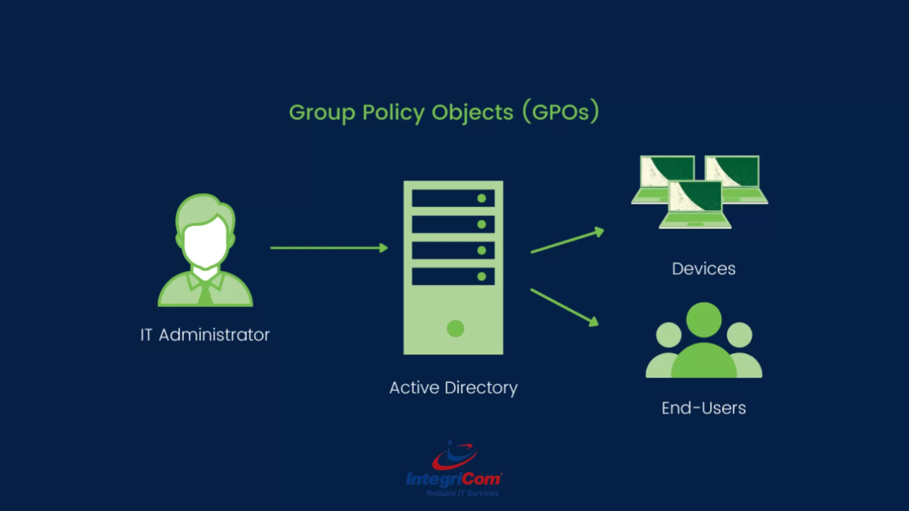

Slide 26
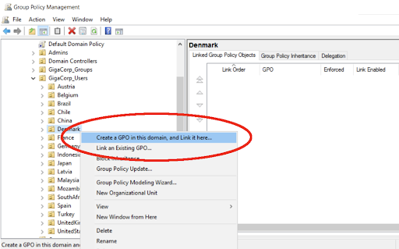

Slide 27
GPO Hierarchy
GPOs are linked to AD containers such as Sites, Domains, Organisational Units, the settings enforced apply to all objects within that container
General processing order:
Local -> Site -> Domain -> OU
Rules:
Last applied wins (typically OU)
GPOs applied at higher levels flow down to lower ones
However, an OU can block Higher-level GPOs
A GPO can be enforced so its settings cannot be overridden by lower-level GPOs

Slide 28
ACLs (Access Control List/s)
Kinda says it in the name, used to define who can access an object and what actions they can perform
Determines whether a user or process can read, write, modify, delete, or audit the project
Consist of Access Control Entities (identifiers, unique SIDs)
Discretionary access control list (allow or deny)
System access control list (defines which actions should be audited, e.g. logs failed read/write attempts by a certain group)

Slide 29
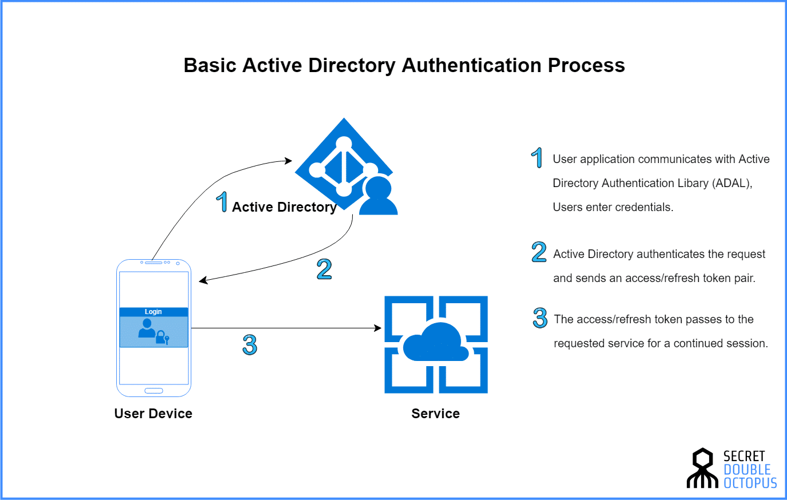

Slide 30
NTLM Relay Attack
A victim tries to authenticate to a malicious server
The NTLM challenge/response is captured by the attacker
The attacker relays it to a legitimate server/service which is then accepted, granting access as the victim machine/user without needing a password

Slide 31
Pass the Hash
Authenticating with a users password hash instead of knowing the password
PtH attacks exploit the NTLM authentication protocol, as it uses a challenge-response mechanism where a user’s password hash (NT Hash) is used to encrypt a server-issued ‘challenge’.
Both NTLMv1 and NTLMv2 are vulnerable to PtH attacks
Best mitigation? disable NTLM

Slide 32
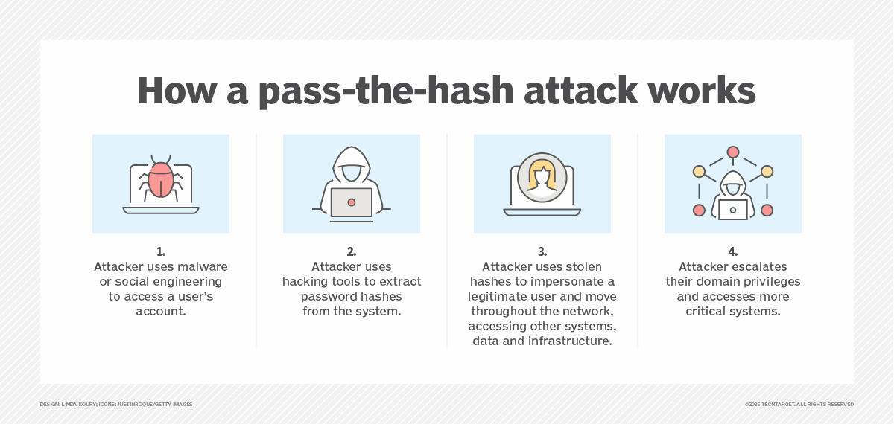

Slide 33
Kerberoasting
In AD, service accounts often have Service Principal Names (SPNs) registered so that Kerberos can issue tickets for them
Targeting Kerberos ticket granting service, when a user requests access to a service, the DC issues a Kerberos TGS ticket encrypted with the service accounts password hash
Attackers can request these tickets for any service account that they can see, without needing elevated privileges
Once obtained, the tickets can be brute forced to recover the password

Slide 34
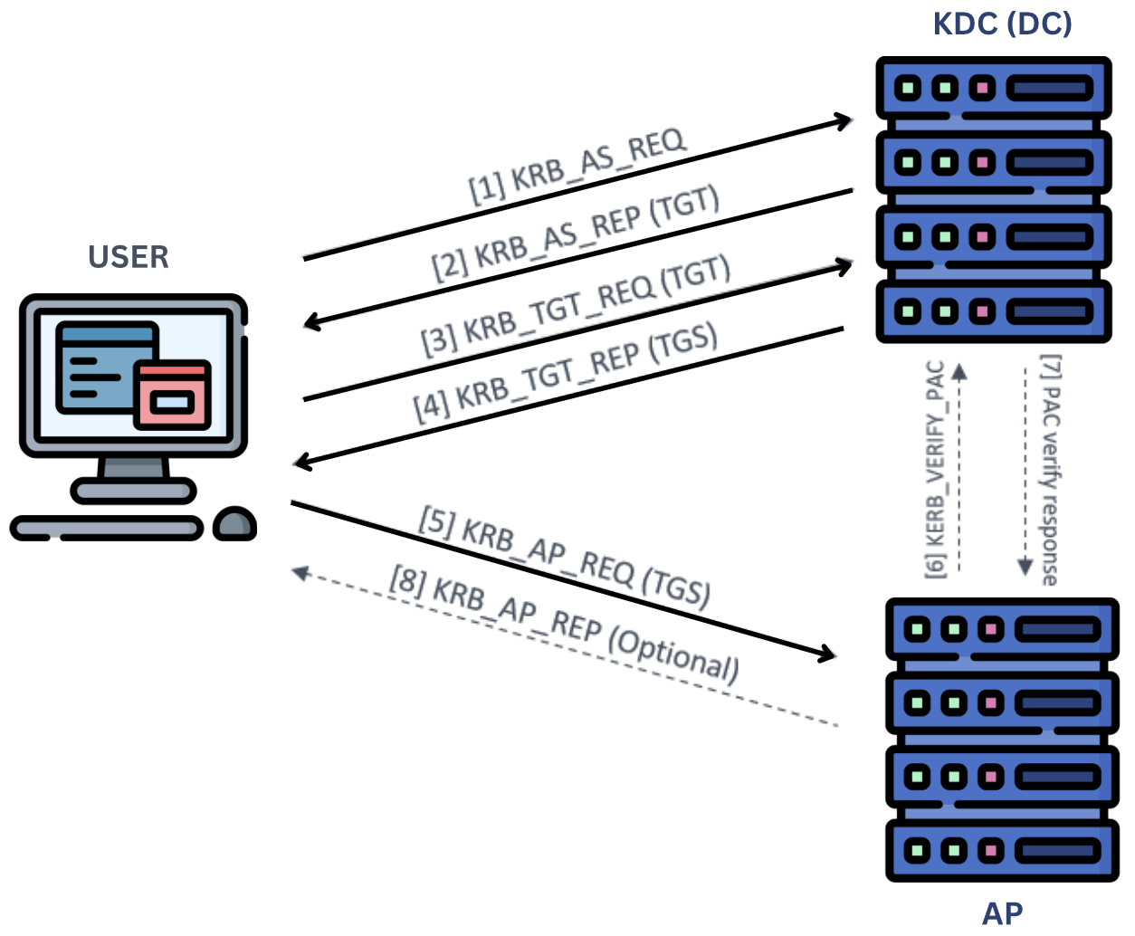

Slide 35
Pass the ticket
Attacker steals valid Kerberos tickets from memory and reuses them on another system without the need of a password
unlike kerberoasting, which cracks the tickets offline in order to actually get the password, PtT directly uses valid stolen tickets to impersonate the user on another system.

Slide 36
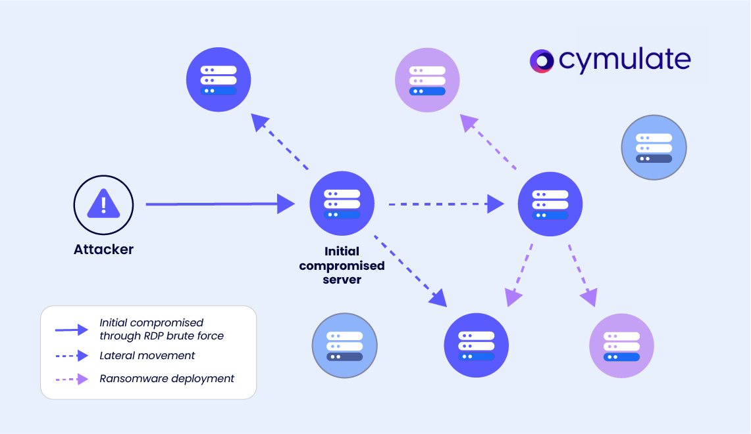

Slide 37
Golden Ticket
forging counterfeit authentication tickets, enabling full domain access, hard to notice and can persist for weeks or months before being noticed
Uses KRBTGT accounts hash(domains root kerberos key), attacker creates their own tickets from scratch with total control
Once again exploits weaknesses in the Kerberos authentication protocol, typically linked to mimikatz

Slide 38
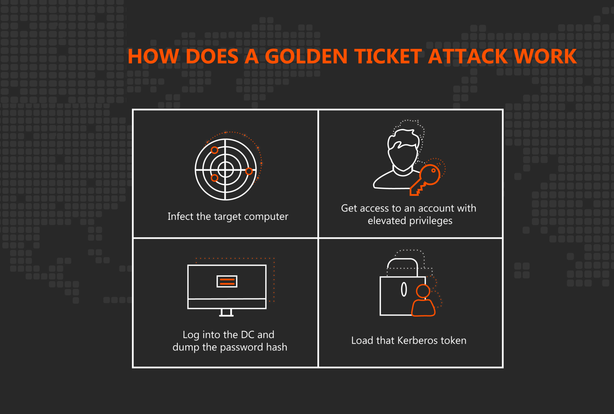

Slide 39
Common Audit Event ID logs
User Account Management: 4720 (created), 4726 (deleted), 4740 (locked out)
Computer Account Management: 4741 (created), 4730 (deleted)
Group Management: 4728 (member added), 4730 (group deleted)
Logon Events: 4624 (successful), 4625 (Failed)
Many many many more logs …….

Slide 40
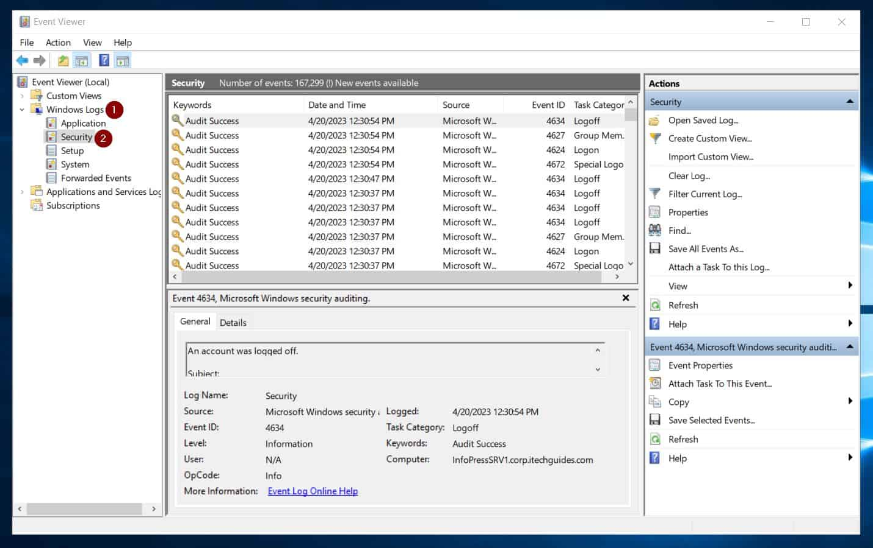

Slide 41
Mimikatz
open source “security research tool” developed in 2011, used to highlight security flaws in authentication mechanisms
allows attackers to extract credentials, including password hashes, Kerberos tickets, and NTLM hashes, which are then used in PtH and ticket forging attacks

Slide 42

Bloodhound
maps out AD objects (users, groups, computers)
accesses and queries relationships in order to identify potential lateral movement and privesc paths that a potential adversary could exploit
used to proactively detect and remediate risks, simulate attacks and find exploitable misconfigurations
helps defensively eliminate exploitable paths within AD

Slide 43
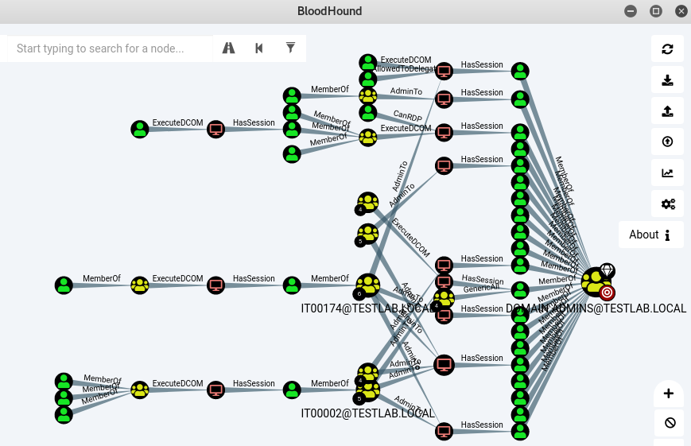

Slide 44
Conclusion
Windows security is…… questionable
this is just the tip of the iceberg, AD is so vast and complex and is riddled with vulnerabilities/ absolute stupidity
I strongly suggest going down the rabbit hole and having a read in your spare time
Confused?

Slide 45
Useful resources
https://ed0x00.github.io/posts/AD-History/
GitHub - infosecn1nja/AD-Attack-Defense: Attack and defend active directory using modern post exploitation adversary tradecraft activity
Microsoft Patches Critical Entra ID Flaw Enabling Global Admin Impersonation Across Tenants
Detecting and mitigating Active Directory compromises | Cyber.gov.au

Slide 46
Todays practical (s)
HARD https://tryhackme.com/room/attacktivedirectory
MEDIUM https://tryhackme.com/room/adbasicenumeration
EASY https://tryhackme.com/room/winadbasics
I would also recommend adding your machine IP to /etc/hosts file
sudo nano /etc/hosts
10.10.10.10 ad.thm
CTRL + X

